Slide 1
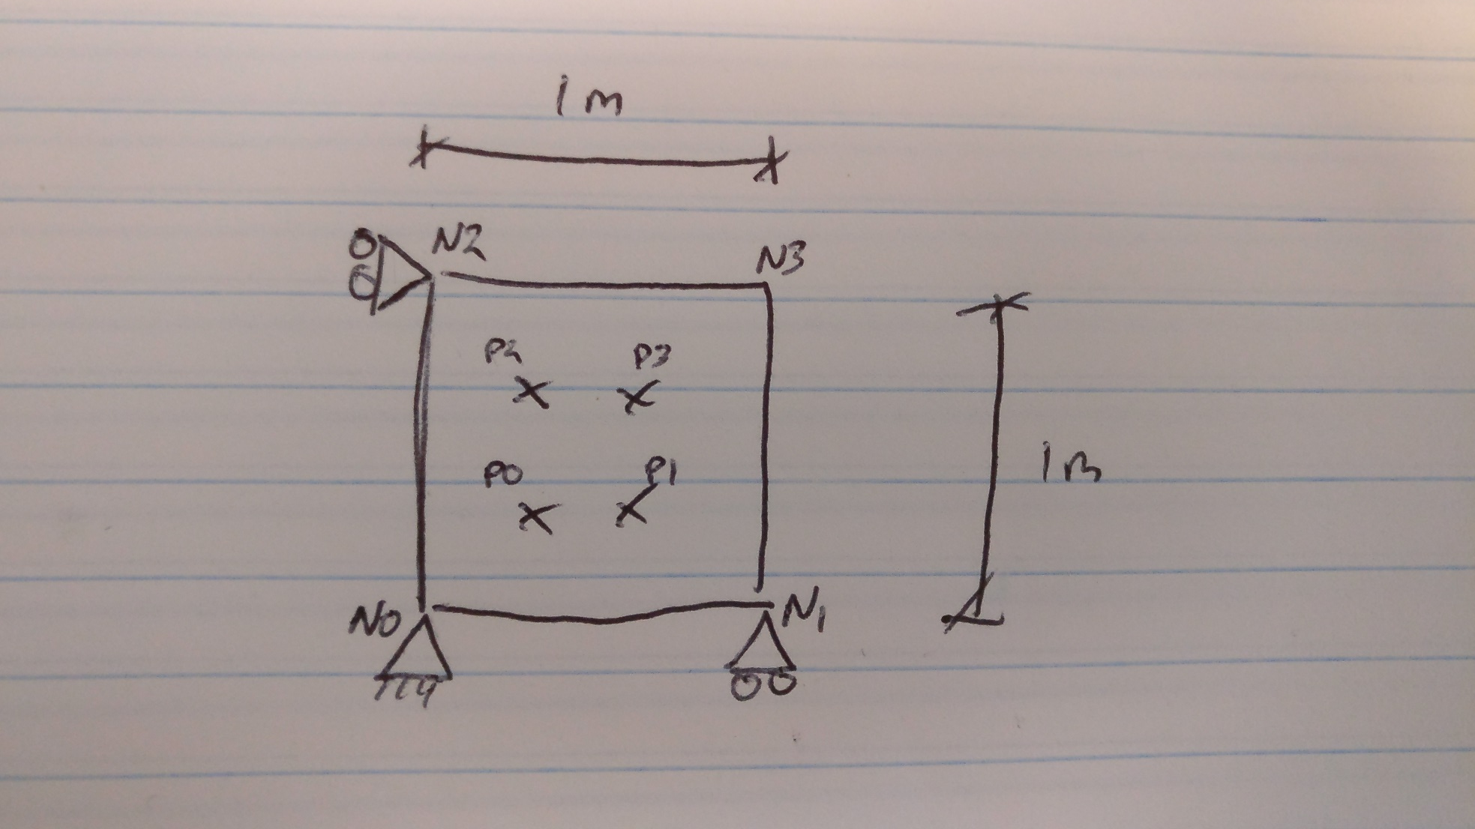
Problem

Slide 2
Internal + External
Node | Initial |  | Final
 | x | y | x | y
0 | 0 | -45424.7 | 0 | -48551.3
1 | 0 | -15141.6 | 0 | -48551.3
2 | 0 | -29575.3 | 0 | -2
3 | 0 | -9858.44 | 0 | -2
Internal
Node | Initial |  | Final
 | x | y | x | y
0 | 0 | 0 | 0 | -38285.6
1 | 0 | 0 | 0 | -38285.6
2 | 0 | 0 | 0 | 38285.6
3 | 0 | 0 | 0 | 38285.6
External
Node | Initial |  | Final
 | x | y | x | y
0 | 0 | -10566.2 | 0 | -10265.7
1 | 0 | -10566.2 | 0 | -10265.7
2 | 0 | -39433.8 | 0 | -38287.6
3 | 0 | -39433.8 | 0 | -38287.6
initial
final

Slide 3
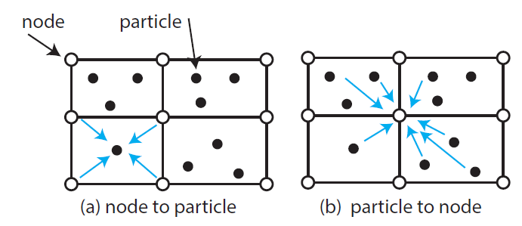
Nodal Forces
Initial:
The internal force is correct
The external:
Total adds up
The distribution to the 4 nodes are not even
Symmetry is observed nevertheless
Final:
The top two points are in force equilibrium
The bottom two points are not

